Slide 1
Charity Network Management System
Team: MOYU
Team Member: Ziyao Qiao, Bo Cao, Yanfei Peng

Slide 2
About our Project
This project is a charity network management system that can enhance communication between donees donors, charity, delivery and government
Charities within the same network can be connected and resource can be shared within the system
Charities have the ability to provide help to poor areas
Government can analysis the network

Slide 3
Project Feature
Feature 1
System handle Message between system users
Feature 2
Government perform analysis based on other department performance
Feature 3
Charity as intermediate manage goods
Feature 4
Total Eco-System Design

Slide 4
Project Approach
Using Java language
Using DB4O, which is an embeddable open source object database
Teamwork, using bitbucket to upload the code and merge it together

Slide 5
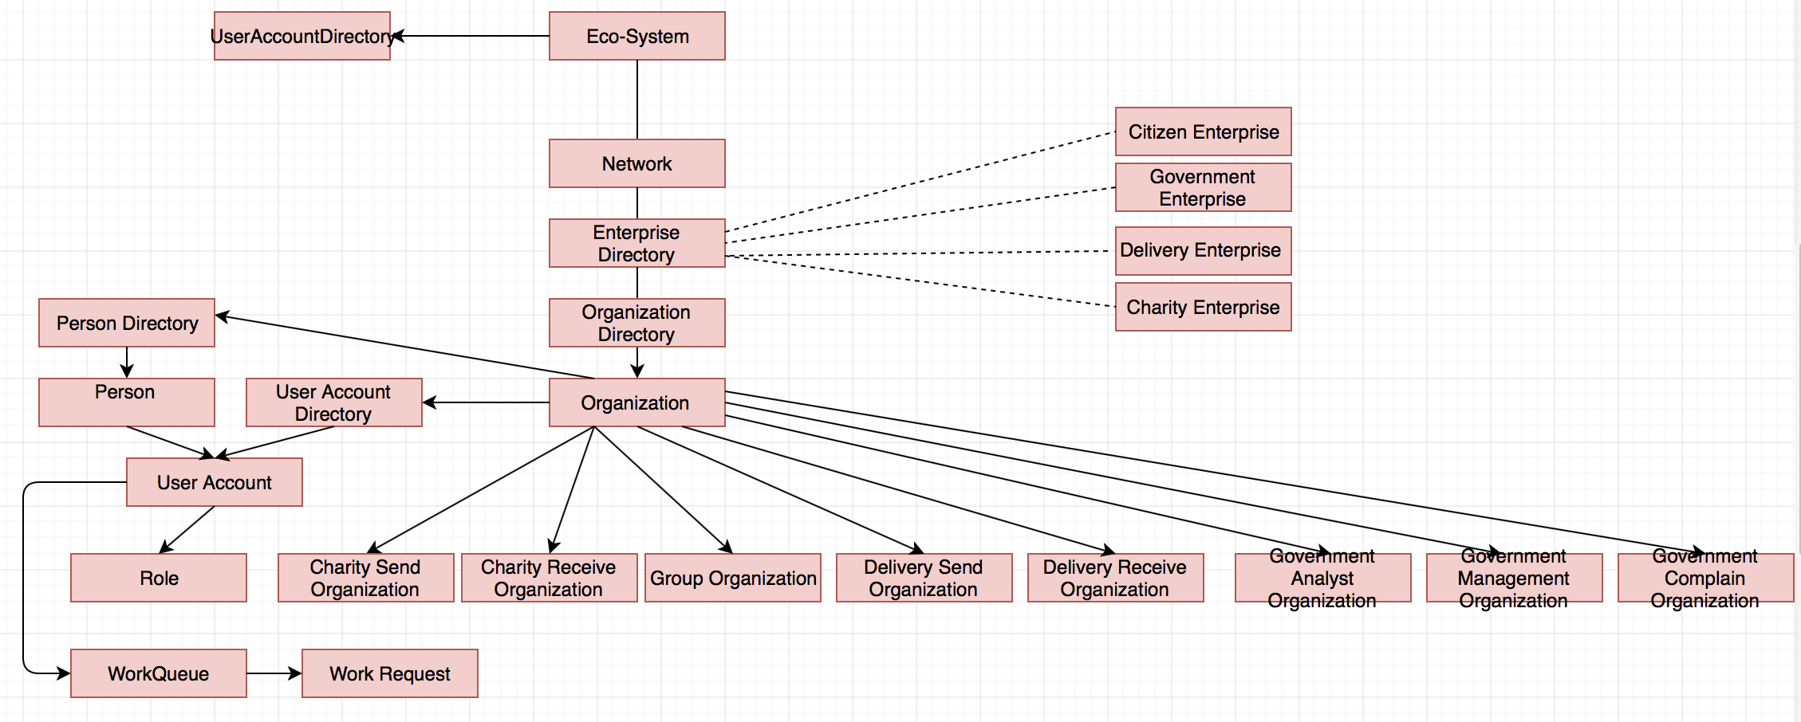
Object Model

Slide 6
System Enterprise
Citizen Enterprise
Perform as Donee
Perform as Donor
Charity Enterprise
Charity Send Role
Charity Receive Role
Charity Manage Role
Delivery Enterprise
Delivery Send Role
Delivery Receive Role
Government Enterprise
Government Handle Complaint
Government Perform Analysis

Slide 7
Use Case - Citizen Role
Citizen can send Donations to Charity to donate goods
Citizen can send a Request List to Charity to request goods
Citizen can view inventory from Charity and order the selected goods from Charity
Citizen can view Requests from other citizens
Citizen can Pin requests from other citizens and view these Pinned requests from other panels
Citizen can send Complains about all charities to Government and reivew these complains

Slide 8
Use Case - Charity Role
Charity can receive goods from citizens
Charity can approve or reject the goods from citizens
Charity can send goods to other organizations for free to face with emergency situations or poor areas
Charity can manage the inventory of all donated goods and update the detail about goods
Charity can check the inventory and check if it is available for donees
Charity can check if a requester is qualified to receive goods

Slide 9
Use Case - Delivery Role
Delivery can receive goods from charity and check the size, distance, weight of this request to generate a price
Delivery can reject goods if they cannot transport
Delivery can process goods to sending facility
Delivery can send goods to Donees

Slide 10
Use Case - Government Role
Government can analysis various data from all charities to have a more general view of this system
Government can view all complaints from citizens and process these complaints
Government can analysis the complain number and see the contrast between finished complain
Government can analysis the delivery speed and efficiency of Delivery Enterprise
Government can analysis the most donated goods and the most required goods

Slide 11
Citizen Role

Slide 12
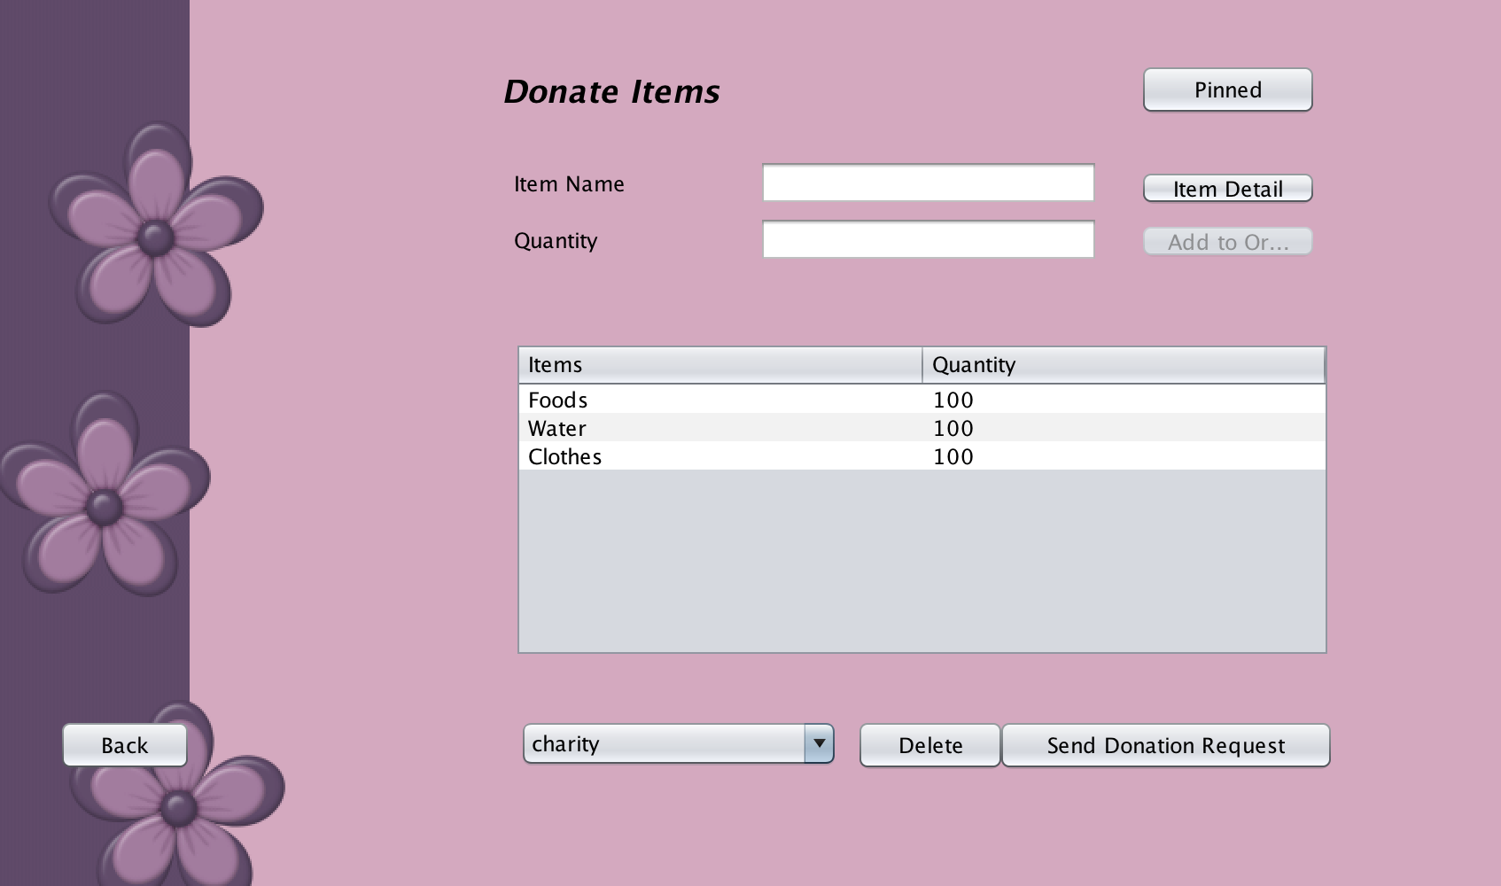
Citizen Donate Item
Donate Item
Input Item detail
Place all Items in donate request
Send request to charity

Slide 13
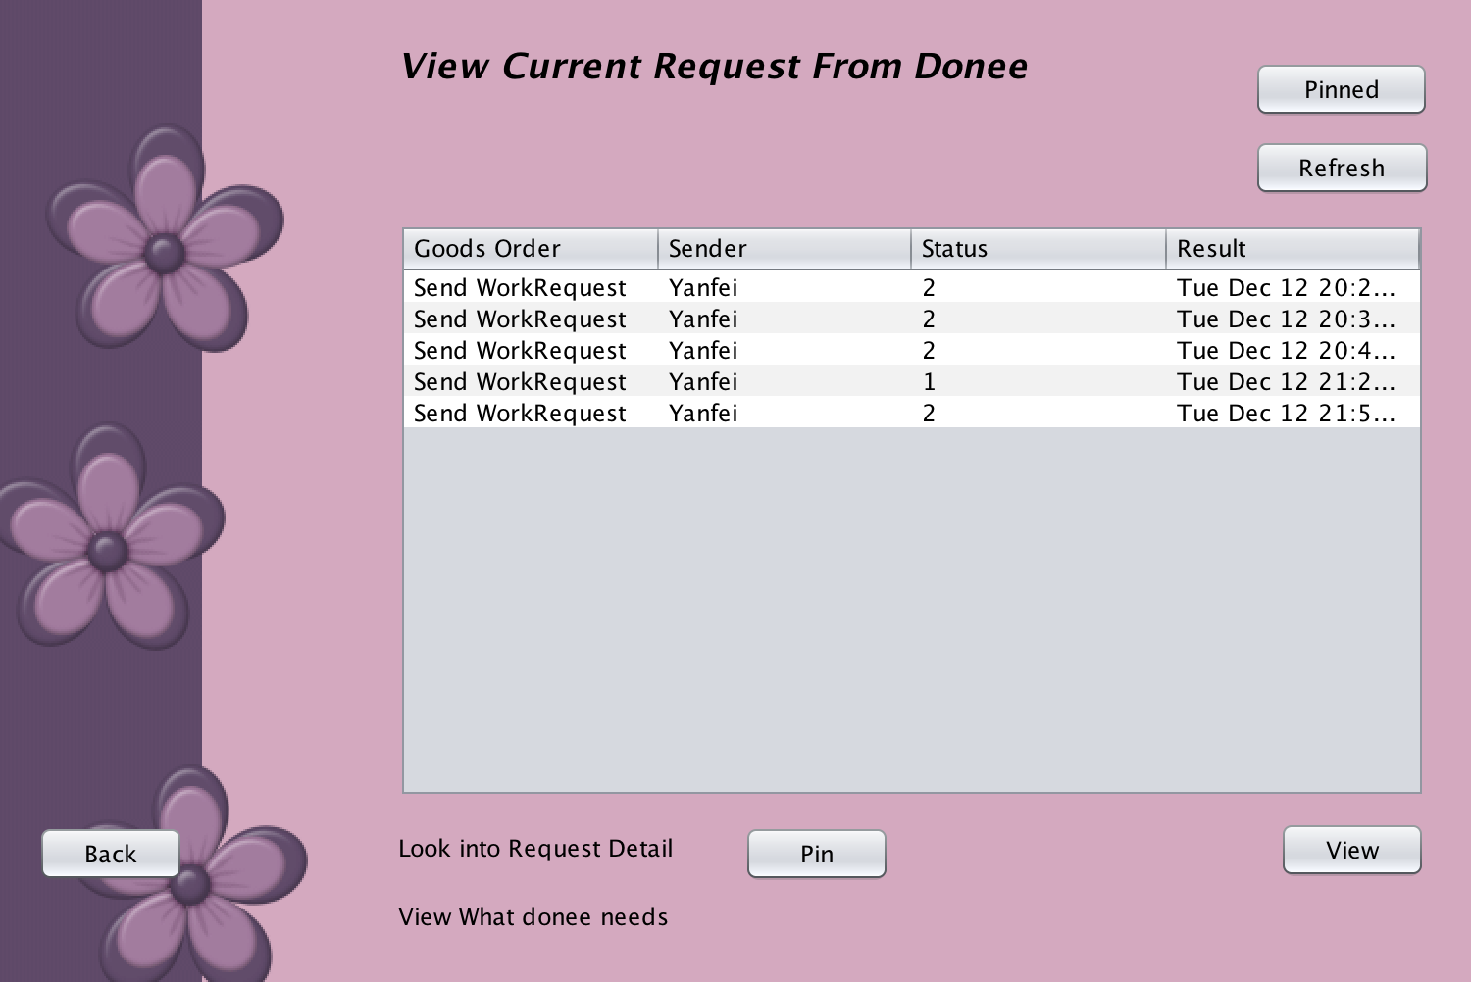
View Request Post
View all current request from donee
Pin selected request to keep track certain request
View request detail

Slide 14
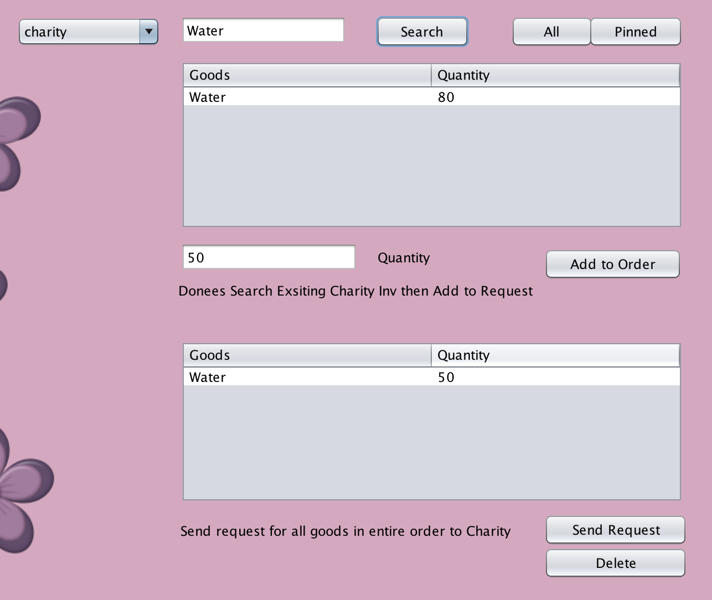
Citizen Search Goods
Search goods by keyword in charity inventory
Add goods into request
Send this request to the charity

Slide 15
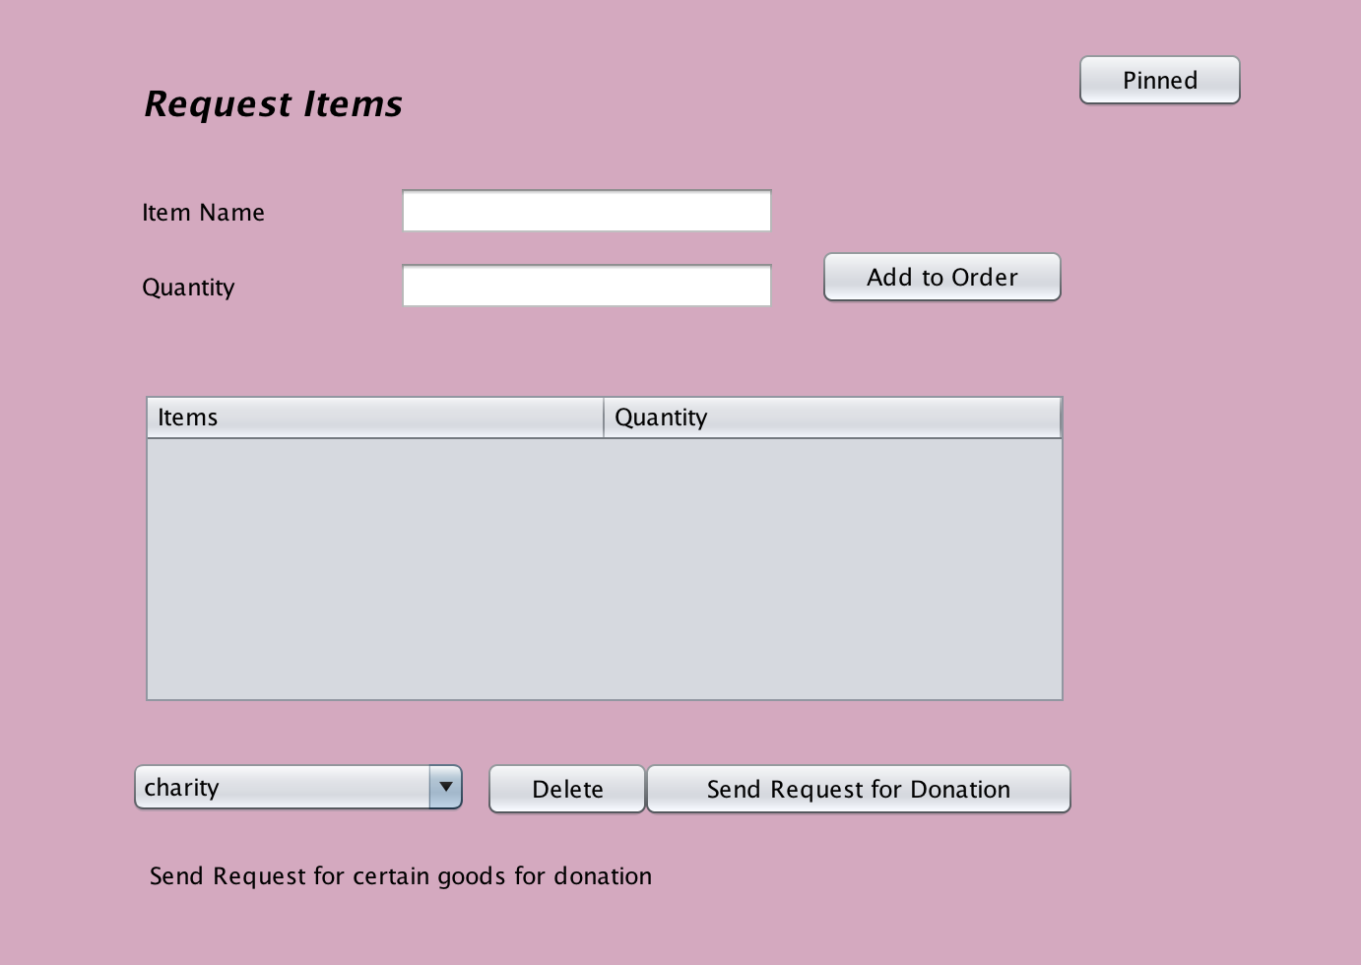
Send Request
Send request for certain goods
Place all goods in order
Send entire order for donation

Slide 16
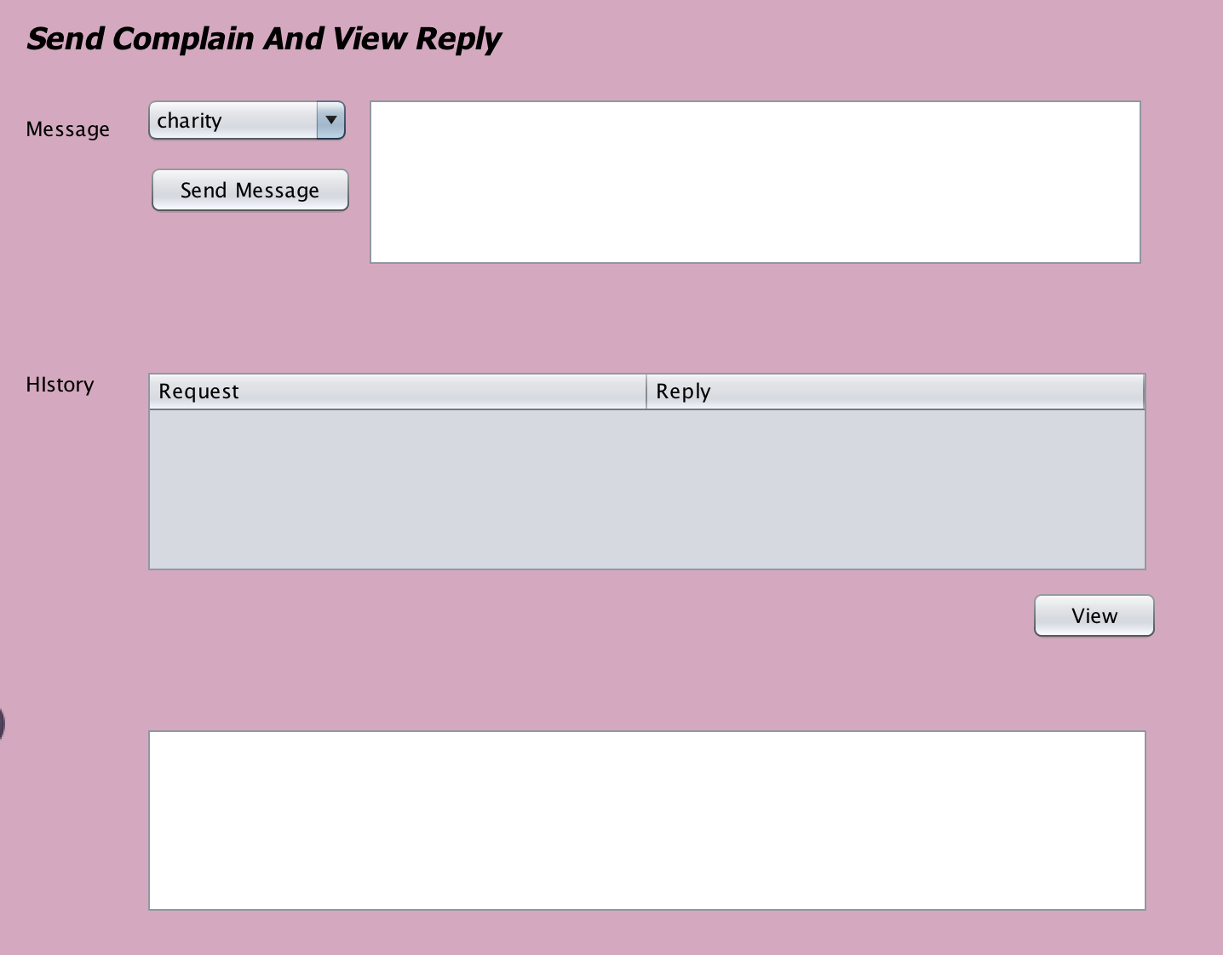
Send Complain & View Reply
Send complain message to local government
View complain History
View complain reply

Slide 17
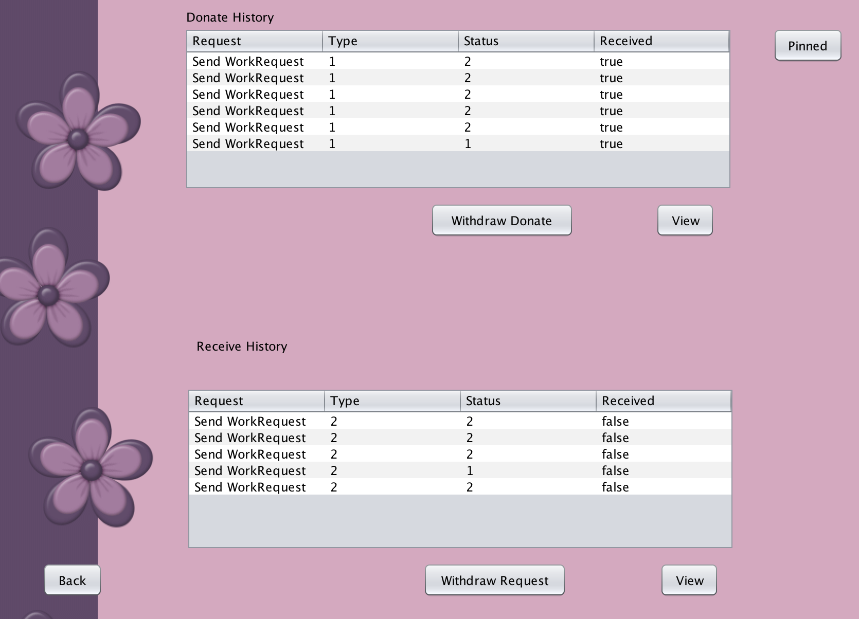
View Request History
View donate request history, which can withdraw request if request has not been received
View request from donee, which can withdraw request if request has not been received
View request detail

Slide 18
Charity Role

Slide 19
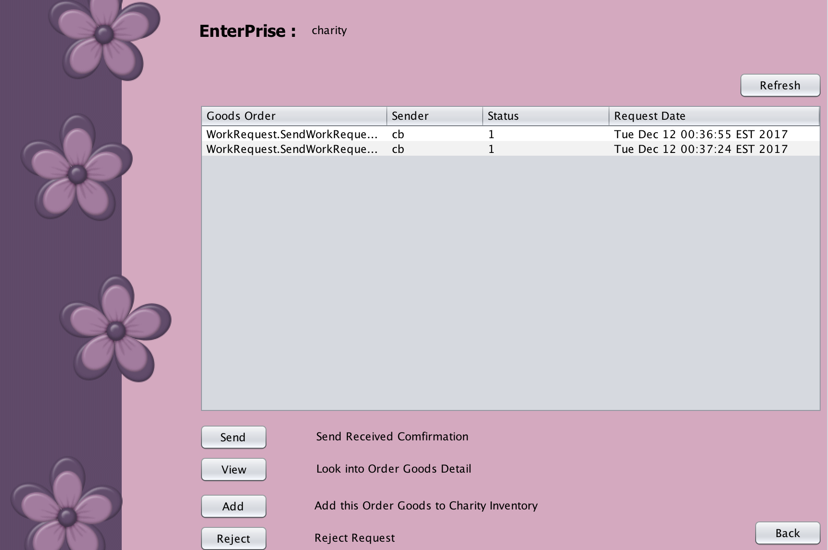
Charity Receive Role
Receive donate Item from citizen
Send confirmation or reject message
View donate order details
Put the goods into inventory

Slide 20
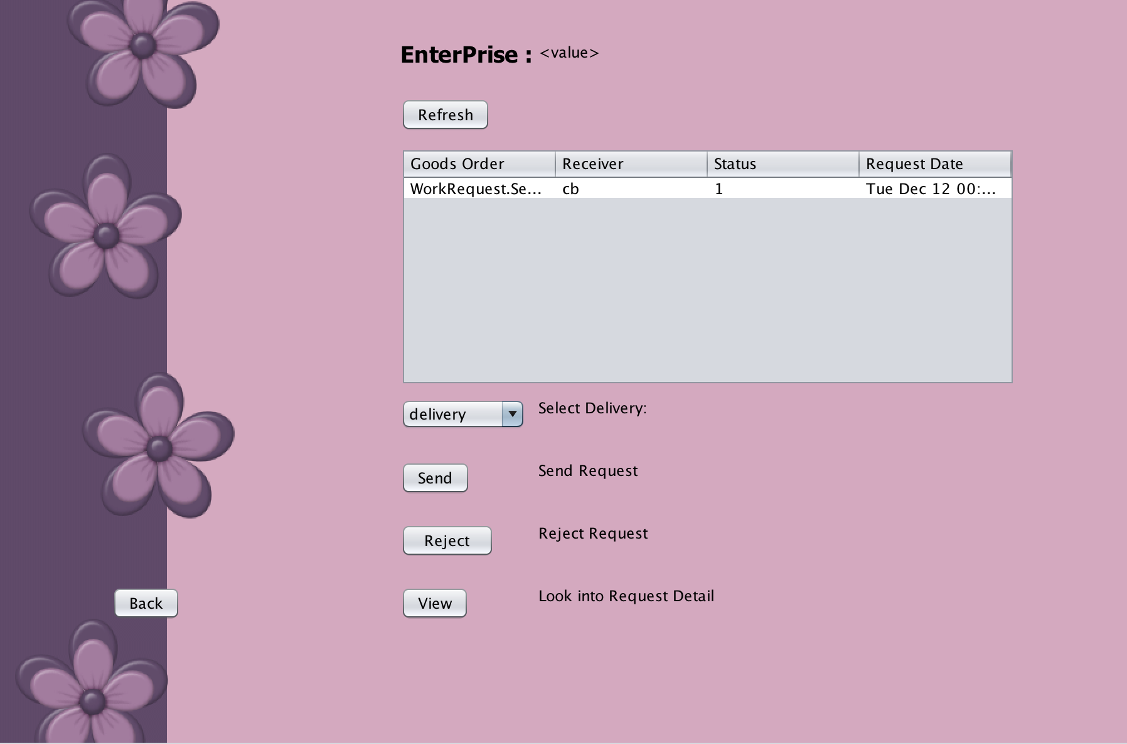
Charity Send Role
Receive goods request from citizen
Send order to the delivery part
Reject the request from citizen
Look into request details
Use engel coefficient to determine if the citizen can request goods

Slide 21
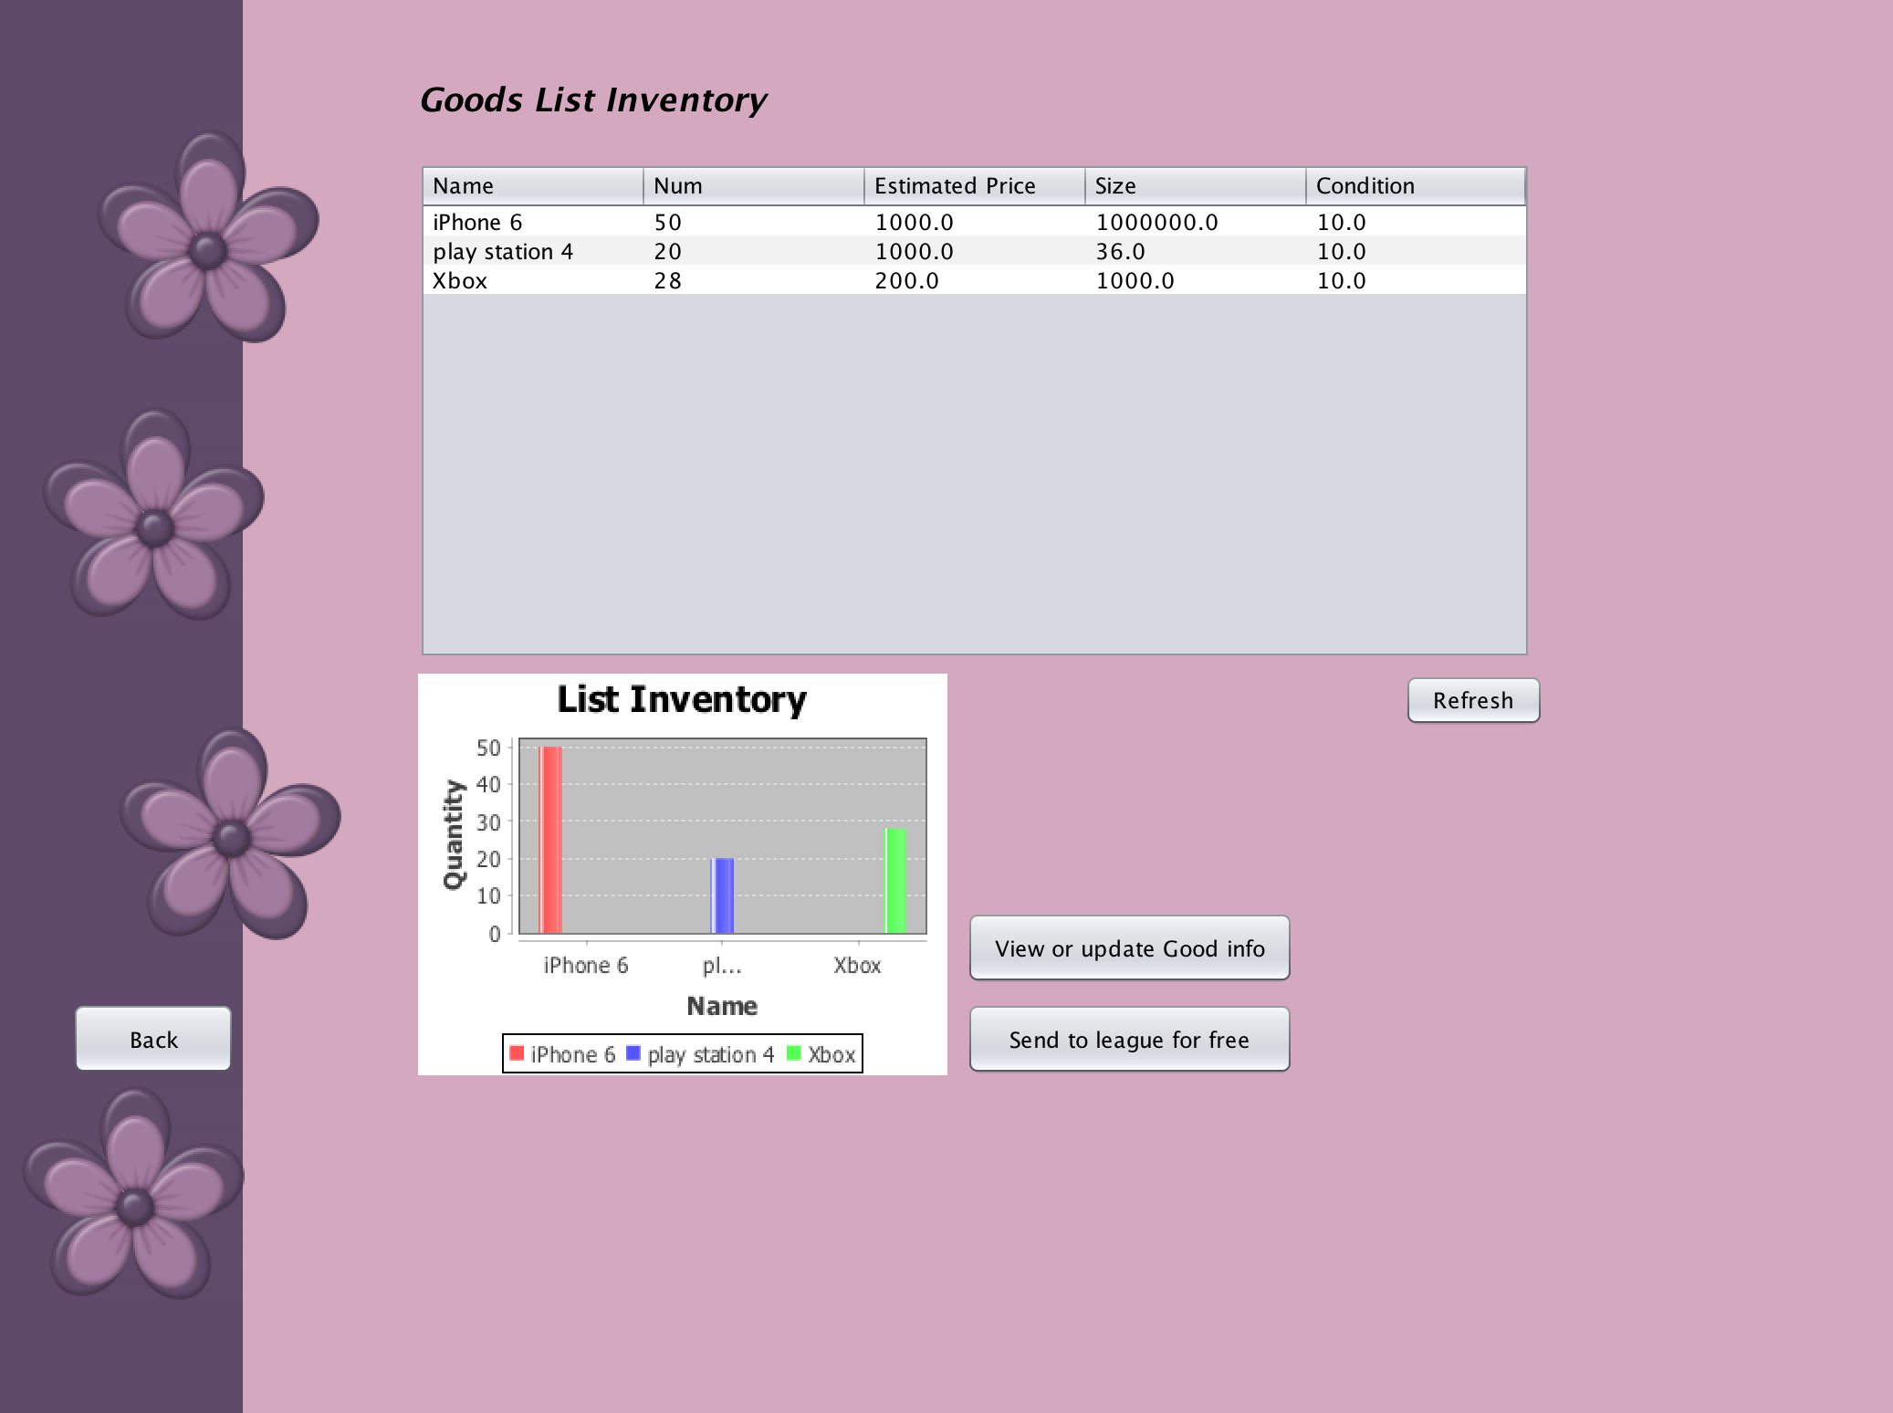
Charity Management Role
Show all goods info. in the inventory
View or update the goods’ information
Use chart to show the amount of inventory
Send the goods to the non-profitable charity league when the disaster happened

Slide 22
Delivery Role

Slide 23
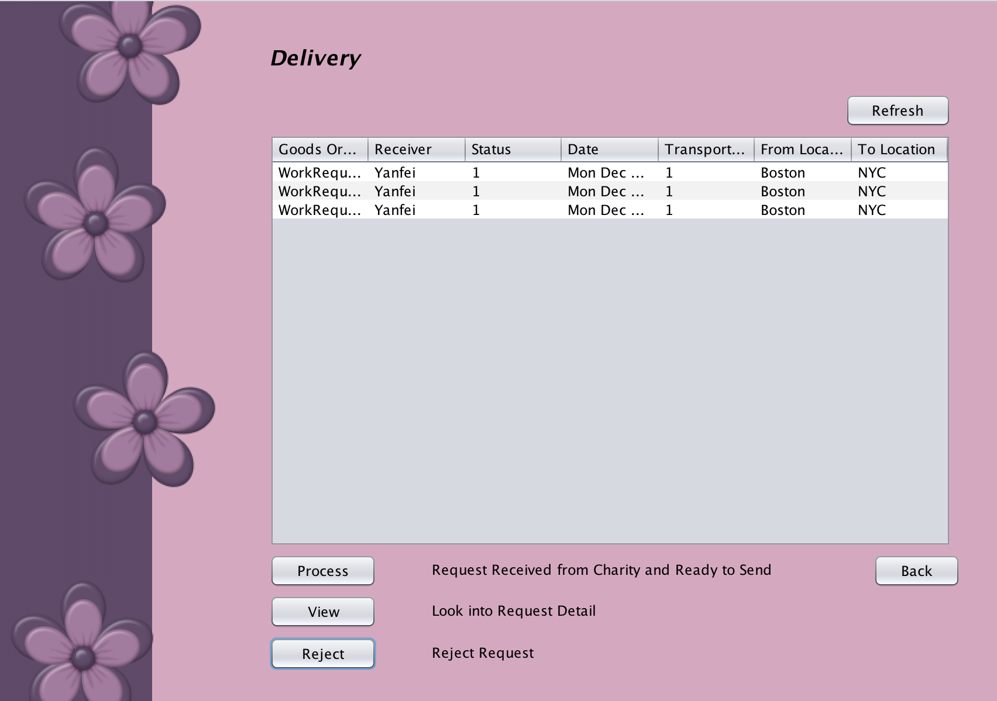
Delivery Receive Role
Request received from charity process this request
View request detail
Reject this sending request
Status: 1 Waiting, 2 Finished， -1 Reject
Transport Type: 1 Pending, 2 processed to Send Facility, 3 Sent, -1 Reject

Slide 24
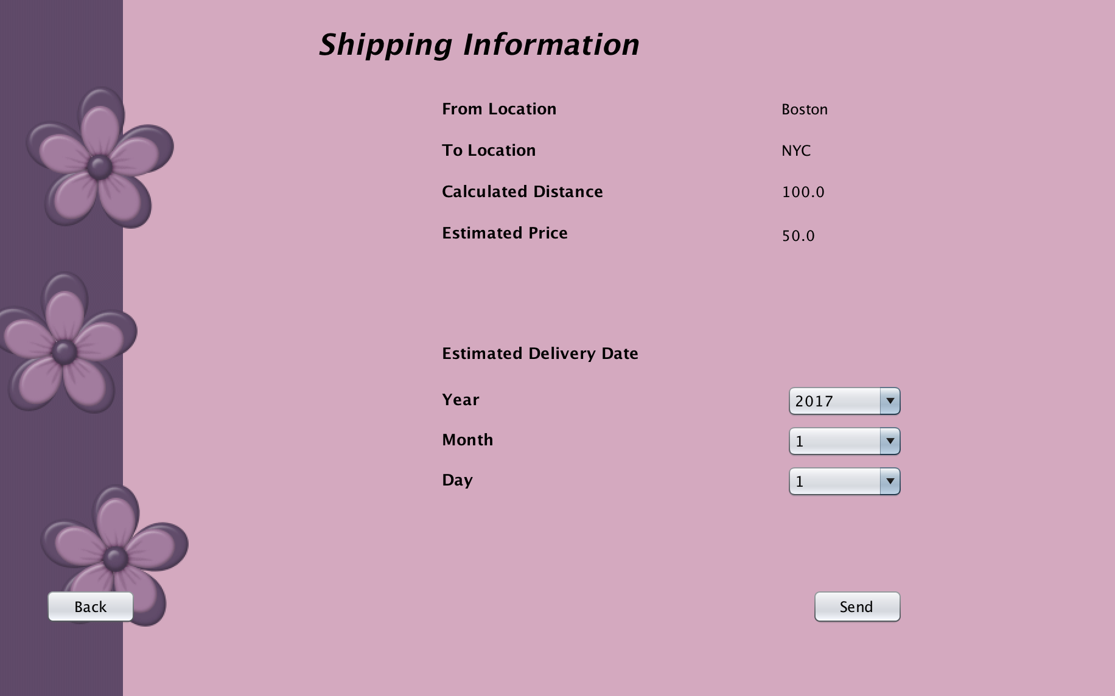
Delivery Information
Calculate Distance by given coordinate of from and to location
Calculate Price by Goods Size, Weight, Distance Range
Choose Estimated Delivery Date

Slide 25
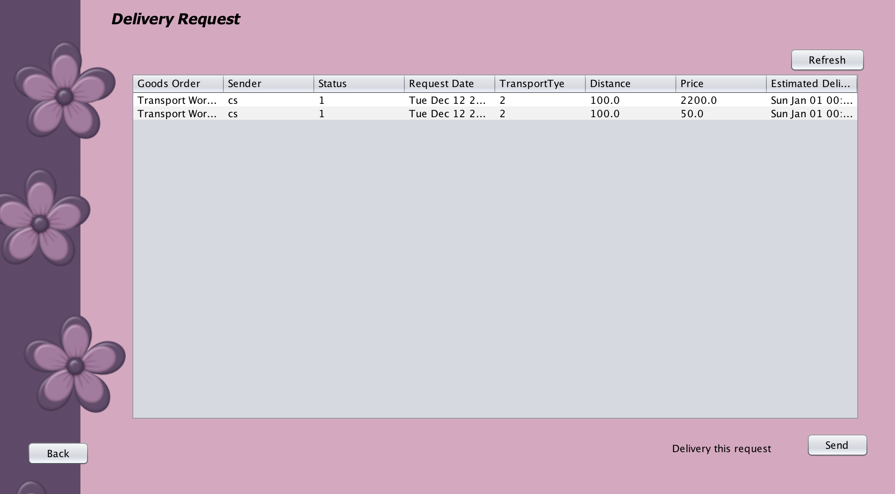
Delivery Send Role
Show all request passed from delivery receive department
Delivery this request to receiver

Slide 26
Government Role

Slide 27
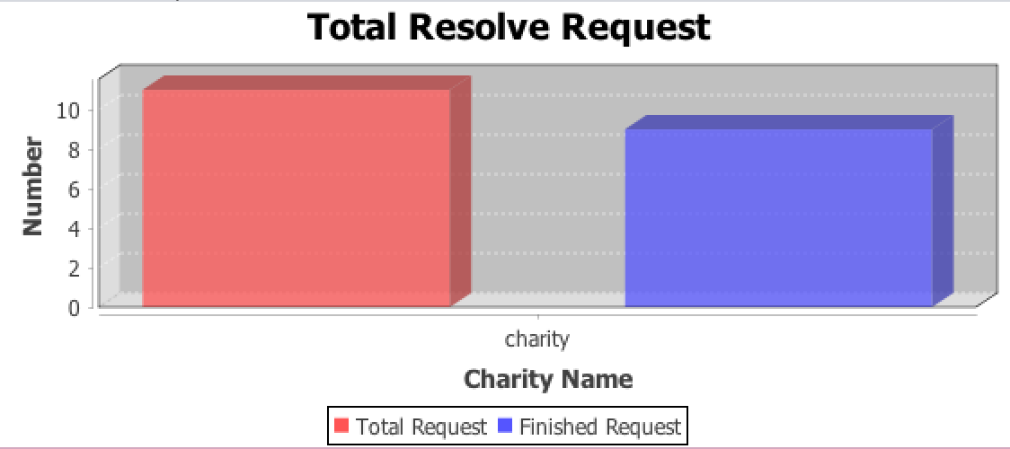
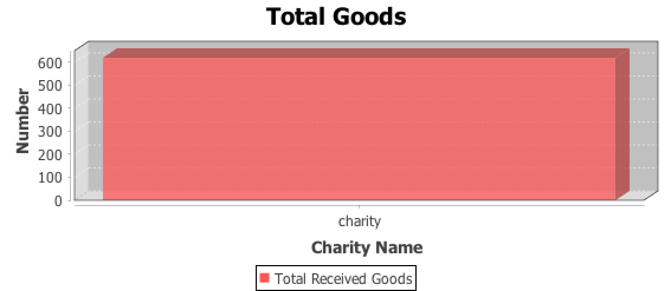
Donation Analysis
Total request compare with finished request
Total goods has been donated to charity

Slide 28
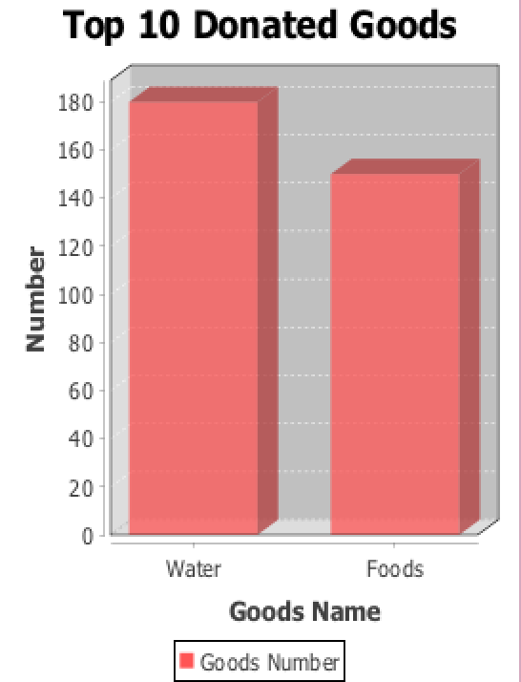
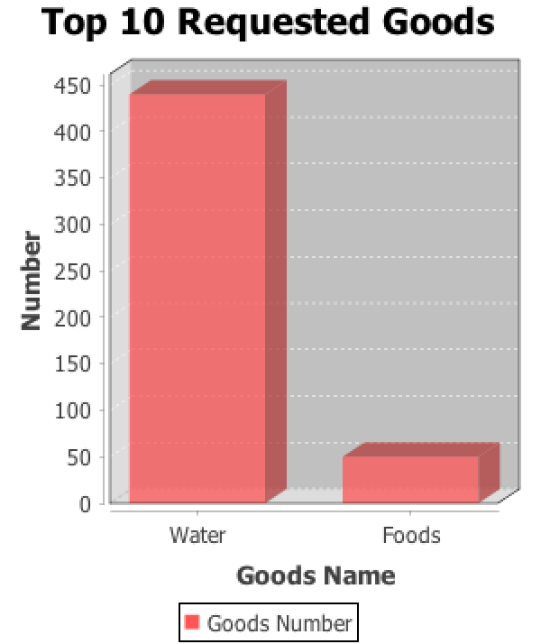
Goods Preference Analysis
Top 10 donated goods
Top 10 requested goods

Slide 29
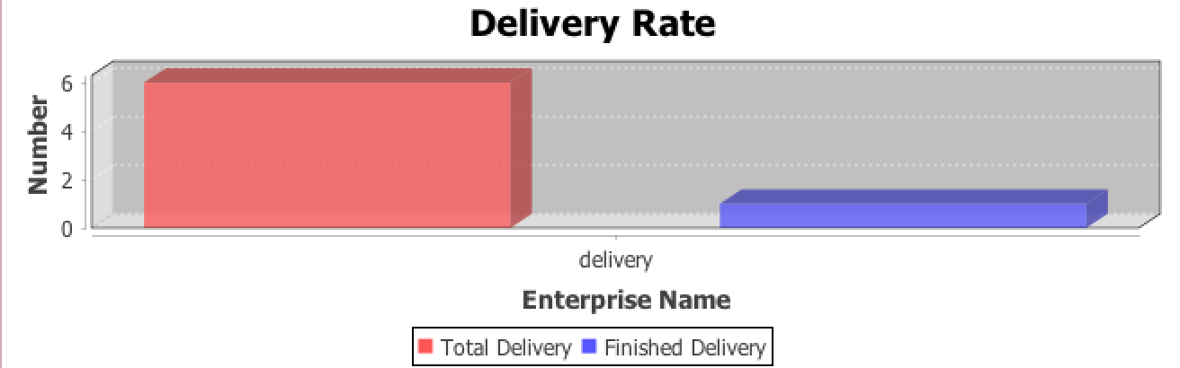
Delivery Analysis
Total request for delivery
Total finished delivery request

Slide 30
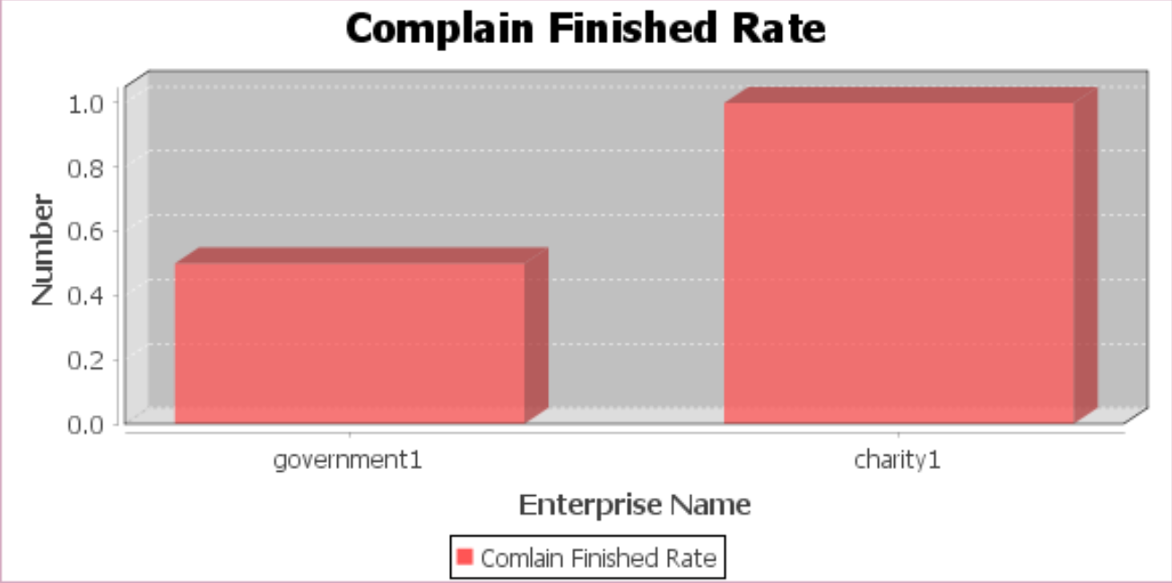
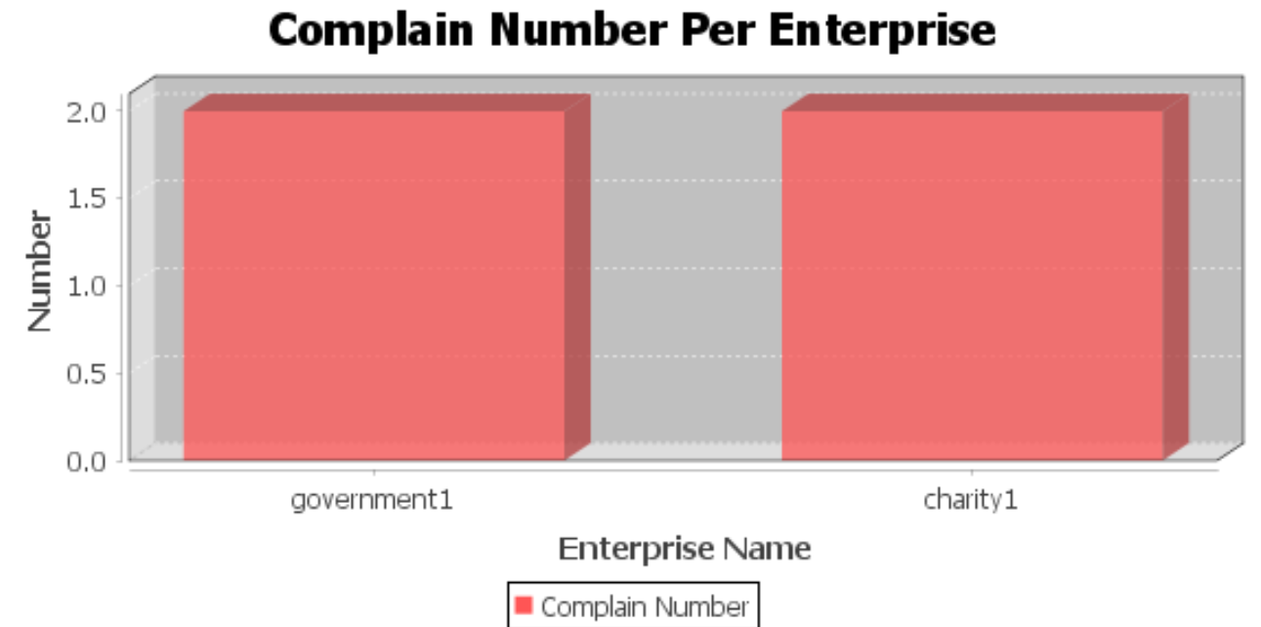
Complaint Rate Analysis
Total request for delivery
Total finished delivery request

Slide 31
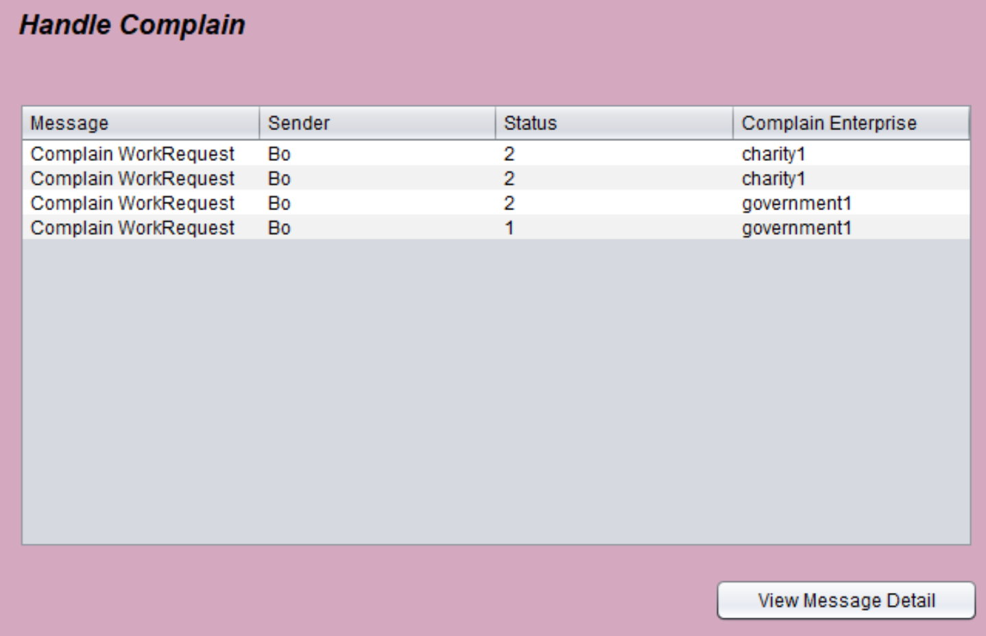
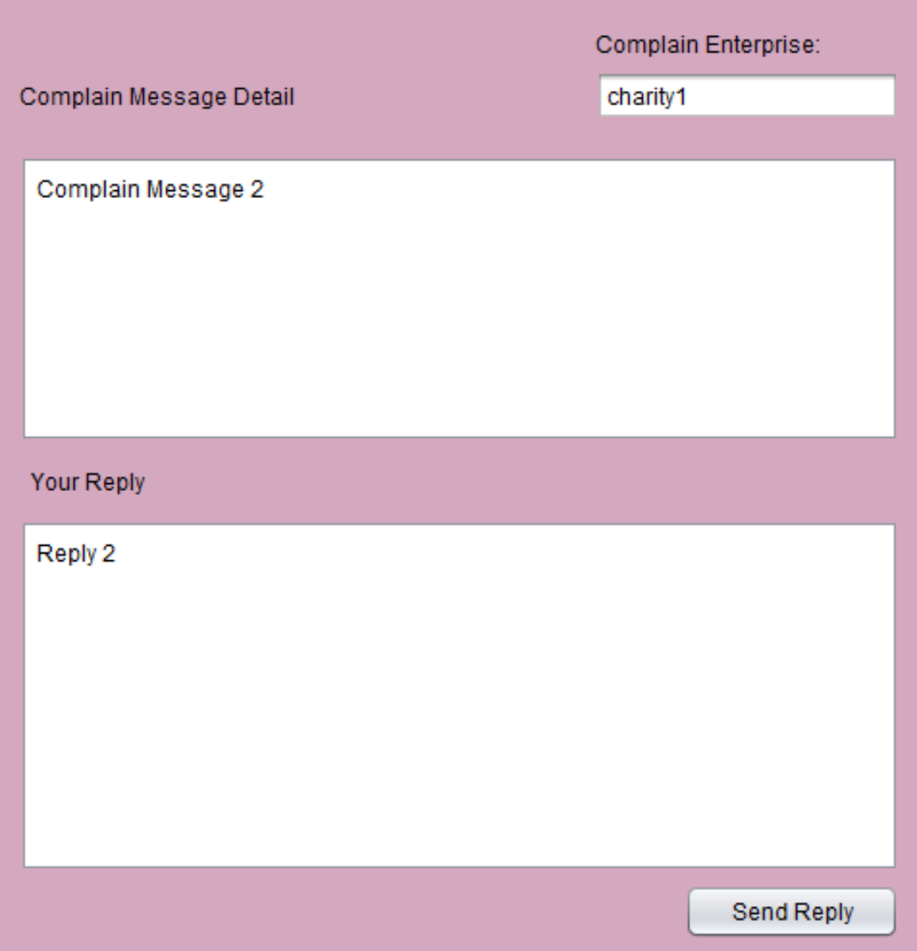
Complain Role
View Complaints from citizens
Handle Complaints

Slide 32
Thank You

